Slide 2
Lesson 3: Object Oriented Design (10hrs)
Writing contracts: Describing and Elaborating Use Cases
Collaboration Diagram and Sequence Diagram
Objects and Patterns (information expert, creator, low coupling, high cohesion, controller)
Determining Visibility
Class Diagram

Slide 3
Patterns
A pattern serves as a guide for creating a “good” design.
The pattern facilitates reuse of knowledge.
Additionally, the pattern helps in the communication among software developers – using the name of the pattern conveys a large amount of knowledge in a very dense way.
Patterns are based on sound common sense and the application of fundamental design principles.
These are created by people who spot repeating themes across designs.

Slide 4
Design Patterns
In software development, a pattern (or design pattern) is a written document that describes a general solution to a design problem that recurs repeatedly in many projects.
Or a pattern is a named description of a problem & its solution that can be applied to new contexts.
Software designers adapt the pattern solution to their specific project.
Considered as a reusable solution for the commonly occurring problems in software design.
A design pattern isn't a finished design that can be transformed directly into code. It is a description or template for how to solve a repeated problem.

Slide 5
Design Patterns
Pattern elements: There are four essential elements of the design patterns:
Name
A name that is a meaningful reference to the pattern
Problem description
Description of the problem and its context.
Solution description
Not a concrete design but a template for a design solution that can be implemented in different ways.
Consequences
The results and trade-offs of applying the pattern.
Helps the designer to understand whether a pattern can be effectively applied in particular situation.

Slide 6
Design Patterns Advantages
It reduces a complex form to a simple one.
It provides clear concept of the problem and its solutions.
It speeds up the development process by providing tested, proven development paradigm.
Patterns allow developers to communicate using well-known, well understood names for software interactions.

Slide 7
Design Patterns
Subject
A: 40 B: 25 C: 15 D: 20
Observer 1
Observer 2

Slide 8
Design Patterns Example
In many real-world situations, we want to create only one instance of a class.
For example, there can be only one active president of a country at any given time.
This pattern is called a Singleton pattern.
Other software examples could be a single DB connection shared by multiple objects as creating a separate DB connection for every object is costly.
Similarly, there can be a single configuration manager or error manager in an application that handles all problems instead of creating multiple managers.

Slide 9
GRASP
GRASP (General Responsibility Assignment Software Principles)
GRASP consist of guidelines for assigning responsibility to classes and objects in object-oriented design
GRASP helps us in deciding which responsibility should be assigned to which object/class i.e., it helps to guide object-oriented design by clearly outlining who does what.
Which object or class is responsible for what actions.
Helps us to define how classes work with one another.

Slide 10
9 GRASP Patterns
Creator
Information Expert
Low Coupling
High Cohesion
Controller
Polymorphism
Indirection
Protected Variations
Pure Fabrication

Slide 11
Design Patterns: Essential Elements
Name
A name that is a meaningful reference to the pattern
Problem description
Description of the problem.
Solution description
Not a concrete design but a template for a design solution that can be implemented in different ways.
Consequences
The results and trade-offs of applying the pattern.
Helps the designer to understand whether a pattern can be effectively applied in particular situation.

Slide 12
GRASP Pattern: Creator
Who creates an Object? Or who should create a new instance of some class?
“Container” object creates “contained” objects.
Decide who can be the creator based on the object's association and their interaction.

Slide 13
GRASP Pattern: Creator
Name: Creator
Problem: Who should be responsible for creating a new instance of some class?
Solution: Assign class B the responsibility to create an instance of class A if one of these is true:
B "contains" or compositely aggregates A.
B records instances of A.
B closely uses A.
B has the initializing data for A that will be passed to A when it is created.

Slide 14

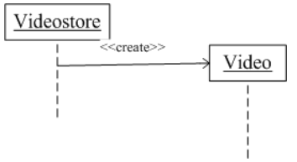
GRASP Pattern: Creator
Consider Video Store and Video in that store.
Video Store has Composite association with Video. i.e, Video Store is the container, and the Video is the contained object or Video is part of VideoStore.
So, we can instantiate video object in Video Store class.

Slide 15
GRASP Pattern: Information Expert
Given an object A, which responsibilities can be assigned to A?
Expert principle says – assign those responsibilities to A for which A has the information to fulfill that responsibility.
They have all the information needed to perform operations, or in some cases, they collaborate with others to fulfill their responsibilities.
Name: Information Expert
Problem: Which class should be responsible for doing certain things?
Solution: Assign responsibility to the class that has the information necessary to fulfill the required responsibility.

Slide 16
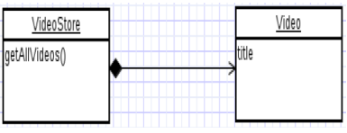
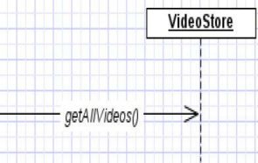
GRASP Pattern: Information Expert
Assume we need to get all the videos of a Video Store.
Since Video Store knows about all the videos, we can assign this responsibility of giving all the videos to Video Store class.
So, Video Store is the information expert.

Slide 17
GRASP Pattern: Low Coupling
How strongly the objects are connected to each other?
Coupling – one object depending on another object.
Low Coupling – How can we reduce the impact of change.
Prefer low coupling – assign responsibilities so that coupling remain low.
Minimizes the dependency hence making system maintainable and efficient.
Name: Low Coupling
Problem: How to support low dependency, low change impact and increased reuse?
Solution: Assign a responsibility so that coupling remains low.

Slide 18
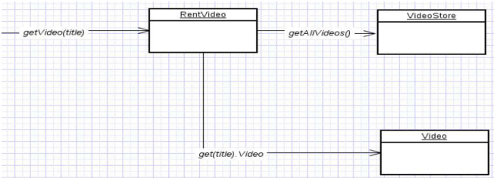
GRASP Pattern: Low Coupling
Two elements are coupled, if
One element has aggregation/composition association with another element.
One element implements/extends another element.
Example of poor coupling. Class Rent knows about both Video Store and Video objects. Rent is depending on both the classes.

Slide 19
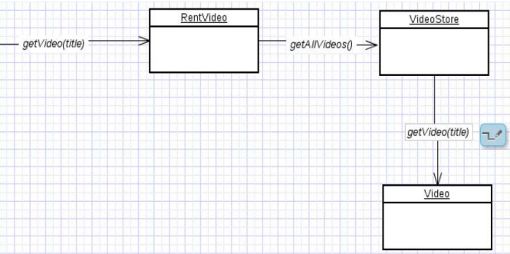
GRASP Pattern: Low Coupling
Video Store and Video class are coupled, and Rent is coupled with Video Store. Thus, providing low coupling.

Slide 20
GRASP Pattern: High Cohesion
Cohesion is the indication of the relationship within a module.
Whereas Coupling is the indication of the relationships between modules.
High cohesion means that the responsibilities of a given element are strongly related and highly focused.
Low cohesion is a situation where a given element has too many unrelated responsibilities.
Name: High Cohesion
Problem: How to keep objects focused, understandable, manageable, and as a side effect, support Low Coupling?
Solution: Assign a responsibility so that cohesion remains high.

Slide 21
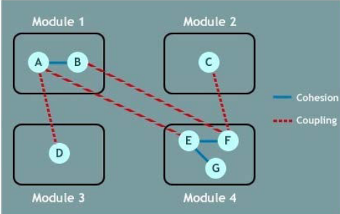
GRASP Pattern: High Cohesion

Slide 22
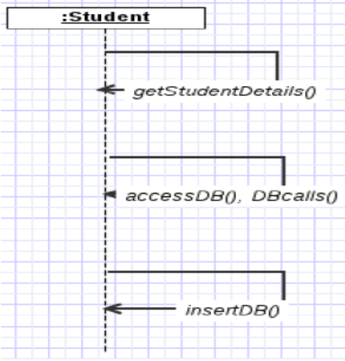
GRASP Pattern: High Cohesion
Low Cohesion Example

Slide 23
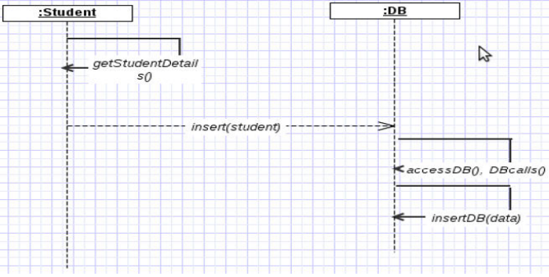
GRASP Pattern: High Cohesion
High Cohesion Example

Slide 24
GRASP Pattern: Controller
A controller is the first object beyond the UI layer that is responsible for receiving or handling a system operation message.
Deals with who should be responsible for handling event from external actors(UI).
Name: Controller
Problem: What first object beyond the UI layer receives and coordinates ("controls") a system operation?
Solution: Assign the responsibility to a class with one of the following choices:
Represents the overall "system.
a root object
a device that the software is running within
a major sub system.

Slide 25
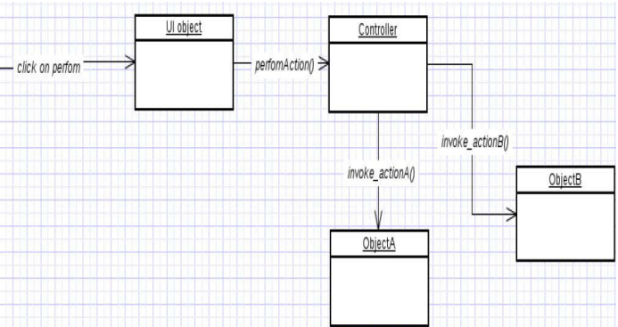
GRASP Pattern: Controller

Slide 26
GRASP Pattern: Polymorphism
Responsibility of defining the variation of behaviors.
How to handle related but varying elements based on element type?
Polymorphism guides us in deciding which object is responsible for handling those varying elements.
Benefits: handling new variations will become easy.
Name: Polymorphism
Problem: How to handle related but varying elements based on element type?
Solution: Assign the responsibility of defining the variation of behaviors to the class implementing polymorphism. This allows for easy handling of new variations by providing different implementations for the varying elements.

Slide 27
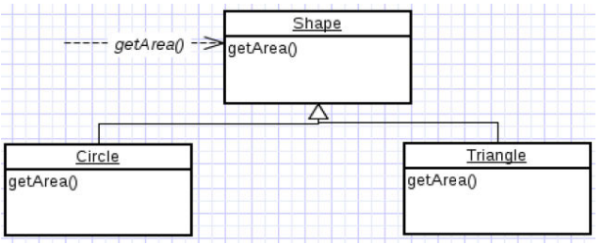
GRASP Pattern: Polymorphism
the getArea() varies by the type of shape, so we assign that responsibility to the subclasses.
By sending message to the Shape object, a call will be made to the corresponding sub class object – Circle or Triangle.

Slide 28
GRASP Pattern: Indirection
The Indirection pattern supports low coupling (and reuse potential) between two elements by assigning the responsibility of mediation between them to an intermediate object.
An example of this is the introduction of a controller component for mediation between data (model) and its representation (view) in the Model-view-controller pattern.
Name: Indirection
Problem: Where to assign a responsibility to avoid a direct coupling?
Solution: Assign the responsibility of mediation between two elements to an intermediate object.

Slide 29
GRASP Pattern: Pure Fabrication
A Pure Fabrication is a class that does not represent a concept in the problem domain
Specially made up to achieve low coupling, high cohesion, and the reuse potential thereof derived
This kind of class is called "Service" in Domain-driven design.
Name: Pure Fabrication
Problem: What object should have the responsibility when there are no good choices?
Solution: Invent a class with a well-defined responsibility.

Slide 30
GRASP Pattern: Protected Variation
Protects elements from the variations on other elements.
Wraps the focus of instability with an interface.
And using polymorphism to create various implementations of this interface.
Name: Protected Variation
Problem: How to design objects, subsystems and systems, so that variations or instabilities in these elements do not have an undesirable impact on other elements?
Solution: Identify points of variation; assign responsibilities to create a stable interface around them.
Note: This is the goal of many “bigger” design patterns, e.g., Wrapper, Abstract Factory, Adapter, Bridge, Façade,…

Slide 31
Design Patterns Types
There are three types of Design Patterns:
Creational Design Pattern
Structural Design Pattern
Behavioral Design Pattern

Slide 32
Creational Design Pattern
This design patterns is all about class creation and instantiation.
This pattern can be further divided into class-creation patterns and object-creational patterns.
While class-creation patterns use inheritance effectively in the instantiation process, object-creation patterns use delegation (allocation/assignment) effectively to get the job done.

Slide 33
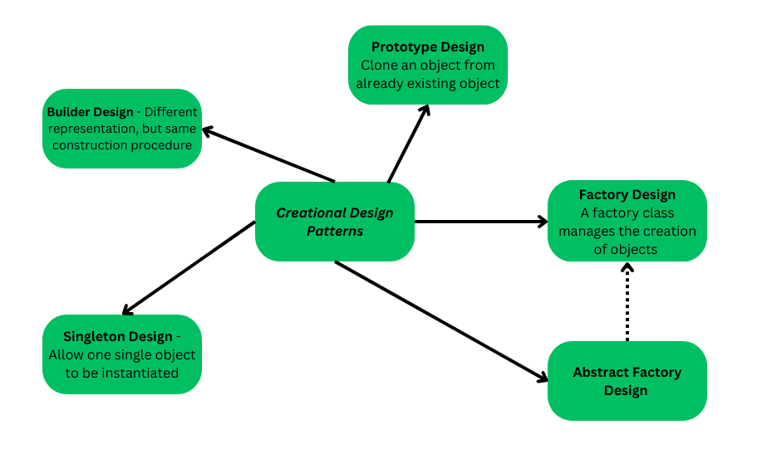
Creational Design Pattern

Slide 34
Structural Design Pattern
This design patterns is all about Class and Object composition.
Structural class-creation patterns use inheritance to compose interfaces.
Structural object-patterns define ways to compose objects to obtain new functionality.

Slide 35
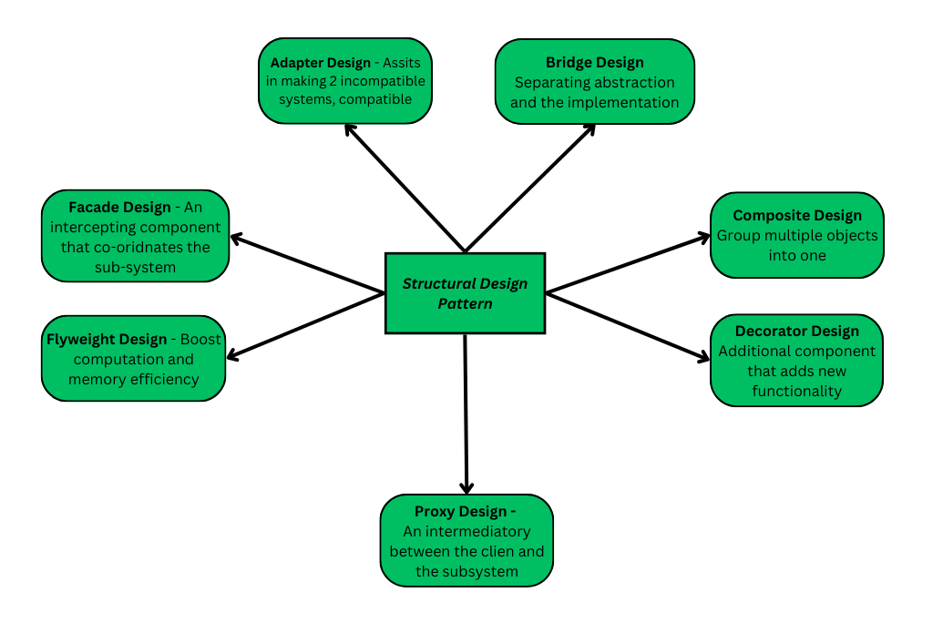
Structural Design Pattern

Slide 36
Behavioral Design Pattern
This design patterns is all about Class's objects communication.
Behavioral patterns are those patterns that are most specifically concerned with communication between objects.

Slide 37
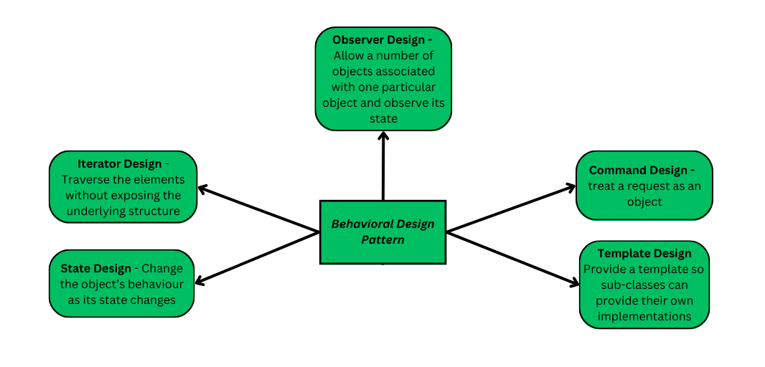
Behavioral Design Pattern

Slide 38
Framework
Framework is a group of concrete classes which can be directly implemented on an existing platform.
They are written in programming languages.
Frameworks are concerned with specific application domain e.g., database, web application etc.
MVC - architecture

Slide 39
Framework
Patterns vs Frameworks
Pattern is a concept while framework is code to be used.
Patterns support reuse of software architecture and design
Patterns capture the static and dynamic structures and collaborations of successful solutions to problems that arise when building applications in a particular domain
Frameworks support reuse of detailed design and code
A framework is an integrated set of components that collaborate to provide a reusable architecture for a family of related application.

Slide 40
MVC Framework
It is a software architectural pattern to implement UI.
It divides the given software application into three interconnected parts, to separate internal representation of information from the ways they are presented to the users.
The central component is MODEL that captures the behavior of the application independent of UI. It manages data, logic and rules of the application.
A VIEW can be any output representation of information visible to the users.
The CONTROLLER accepts input and converts it to commands for the model or view. It links model and view together.

Slide 41
MVC Framework
View
User Input
Updates
Controller
Model
Modifies

Slide 43
PREVIEW FOR LECTURE 13
DETERMINING VISIBILITY

